Slide 1
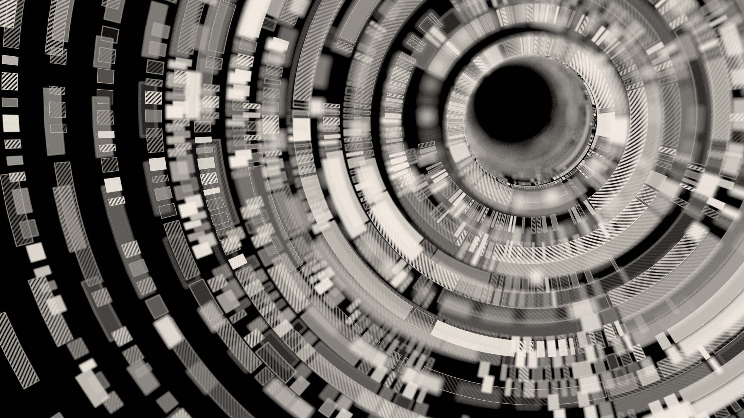
Evaluating the Reproducibility of Training GAN with Limited Data
INTRO DEEP LEARNING Semester Project - Final Report
Deep(FAMS): Mohammad Alyetama, Ali Al-Ramini, Fangyi Li

Slide 2
Introduction
Background
Generative Adversarial Networks (GANs) is a generative modeling approach using deep learning techniques, to automatically discover and learn the input patterns to generate an output.
Issues with GAN models
GANs are limited to smaller sized datasets
Overfitting
Augmented distribution
Applying a wide range of augmentation using an adaptive discriminator augmentation (ADA) mechanism based on Karras et. al (2020).

Slide 3
Introduction
Objectives & Approach
Evaluation of ADA mechanism with small datasets:
Are we able to reproduce good results as paper reported?
We used StyleGAN2-ADA with some of the same datasets as used in the paper.
Are we able to produce good results with other datasets?
We evaluated replicability of StyleGAN2-ADA using other small datasets.
Any advantage of ADA mechanism?
We trained StyleGAN2 models and compared results with StyleGAN2-ADA.
Any effect on training results when the quantity of the data is limited?
We artiﬁcially subset a relatively large dataset, FFHQ, into different sizes then make comparison with and without ADA.

Slide 4
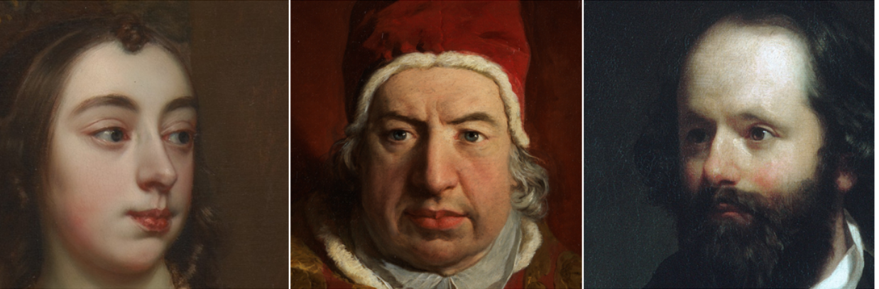
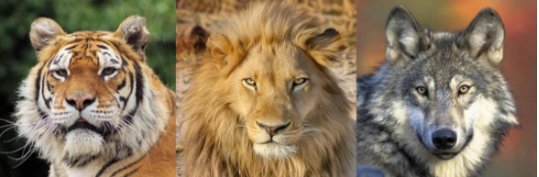
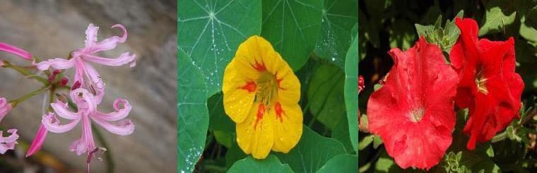
Experimental Setup
DATASETS
Dataset | No. of images
METFACES | 1,336
Animal-Faces-High-Quality (AFHQ) | WILD: 4,738 DOG: 4,739
Cars196 | 16,185
OxfordFlowers102 | 6,149
Flickr-Faces-High-Quality (FFHQ) | 52,000

Slide 5
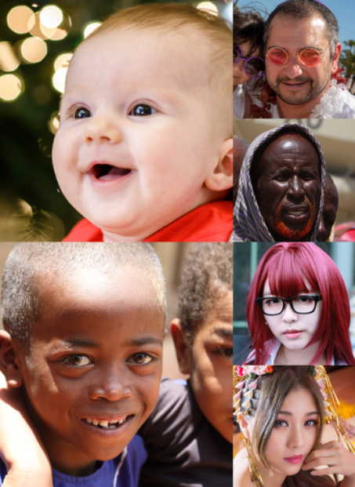
Experimental Setup
Preprocessing
Resizing
We resize our dataset to half the original size that was used in the paper, that is, a resized resolution of (256 X 256) for all datasets except for the METFACES dataset, which we resized to (512 X 512).
Data Splitting
We use data splitting on FFHQ (Flickr-Faces-High-Quality) to measure the performance of StyleGAN2-ADA over portions of data.

Slide 6
Experimental Setup
Architecture
Architecture
The StyleGAN2-ADA mechanism is implemented on top of the StyleGAN2 ofﬁcial TensorFlow implementation with most of the details unchanged, including network architectures.
Data Augmentation
One of the major improvements in StyleGAN2-ADA is dynamically changing the amount of image augmentation during training.
These augmentations consist of 18 transformations: geometric (7), color (5), filtering (4), and corruption (2).

Slide 7
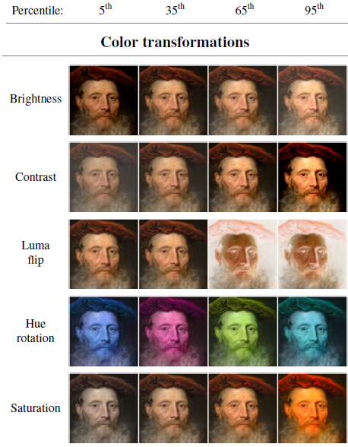
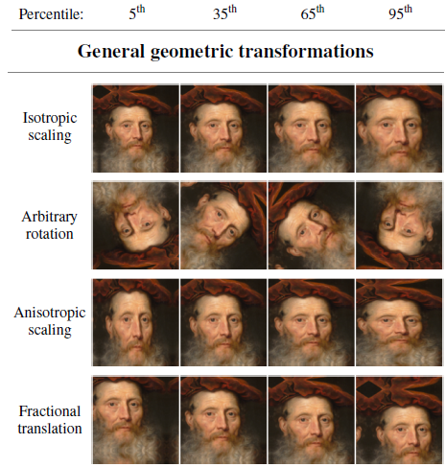
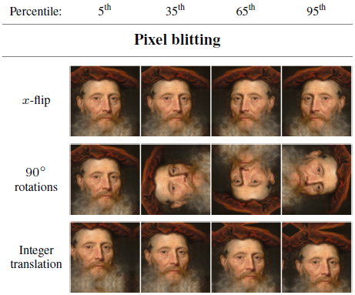
Experimental Setup
Data Augmentation Pipeline
Geometric and color transformations
Pixel Blitting
General geometric transformations
Color transformations
T. Karras, M. Aittala, J. Hellsten, S. Laine, J. Lehtinen, and T. Aila, “Training generative adversarial networks with limited data,” arXiv, 2020.

Slide 8
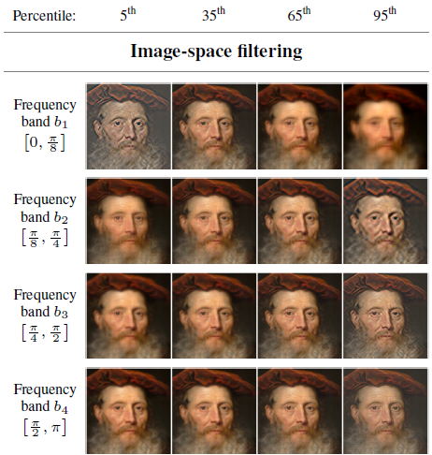
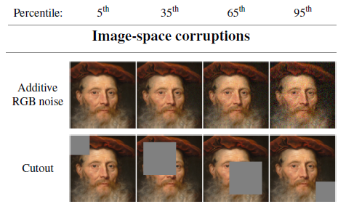
Experimental Setup
Data Augmentation Pipeline
2. Image-space filtering and corruptions
Image-space filtering
Image-space corruptions
T. Karras, M. Aittala, J. Hellsten, S. Laine, J. Lehtinen, and T. Aila, “Training generative adversarial networks with limited data,” arXiv, 2020.

Slide 9
Experimental Setup
Hyperparameters & Evaluation
Evaluation
We used FID metric to evaluate our results, and compare it to the FID scores obtained from the original paper.
Parameter | METFACES | AFHQ-WILD | AFHQ-DOG | Cars196 | Oxford Flowers102 | FFHQ
Resolution | 512*512 | 256*256
No. of GPUs (Tesla V100) | 2
Base feature maps | 16,384 | 8,192 | 5,000 | 16,185 | 8,192 | 52,000
Training time (hrs) | 92.05 | 132.64 | 93.22 | 146.46 | 120.84 | 71.45
Minibatch size | 16 | 32
Minibatch stddev | 4 | 4 | 16 | 16 | 4 | 16
Learning rate | 0.0025
R1 regularization | 3.2768 | 0.4096
Dataset x-flips; Mixed-precision; Mapping net depth; Style mixing reg.; Path length reg.; Resnet D | Yes | Yes | Yes | Yes | Yes | Yes

Slide 10
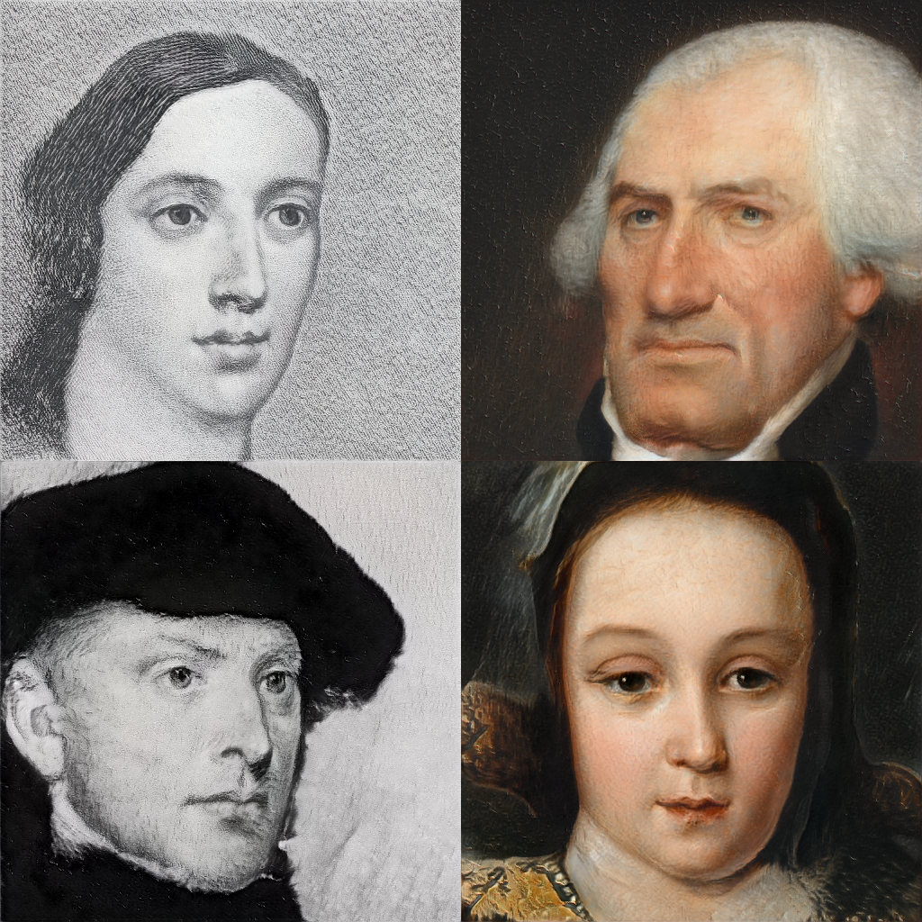
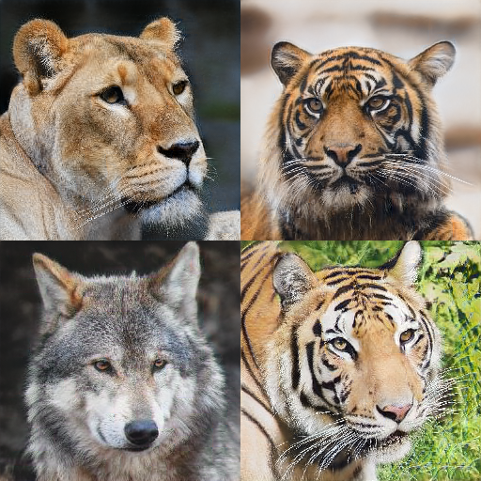
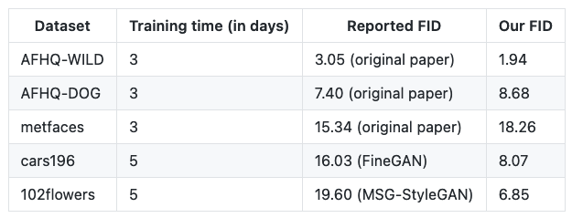
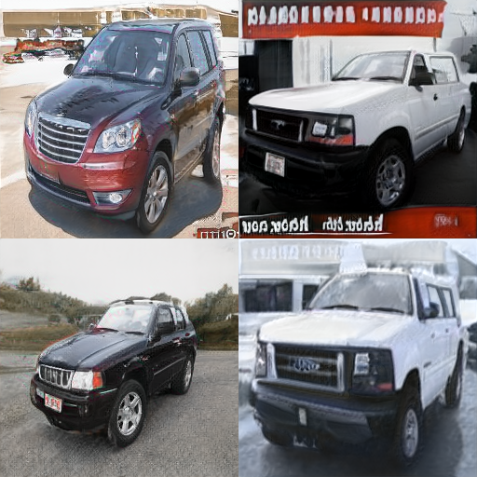
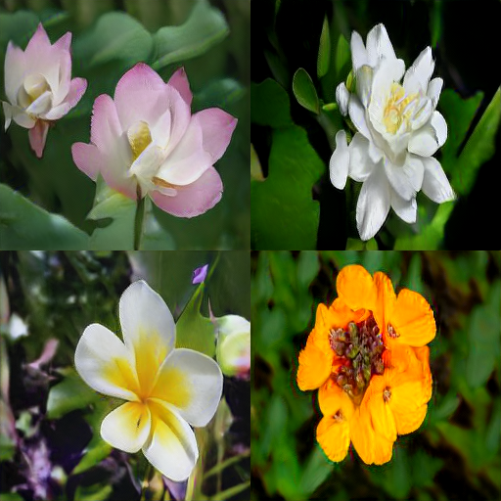
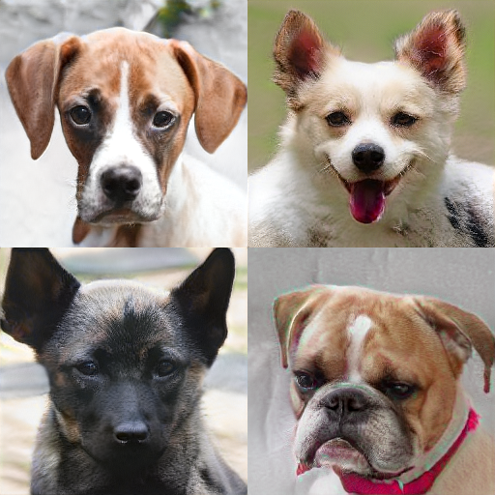
Results
Table 1. Final FID scores of datasets trained from scratch with StyleGAN2-ada
Figure 1. Example snapshots from various datasets trained with StyleGAN2-ada.

Slide 11
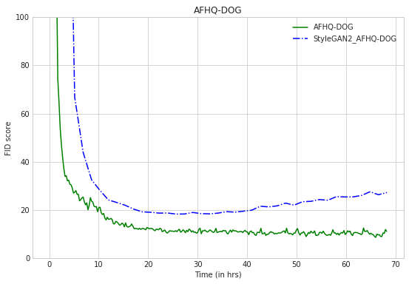
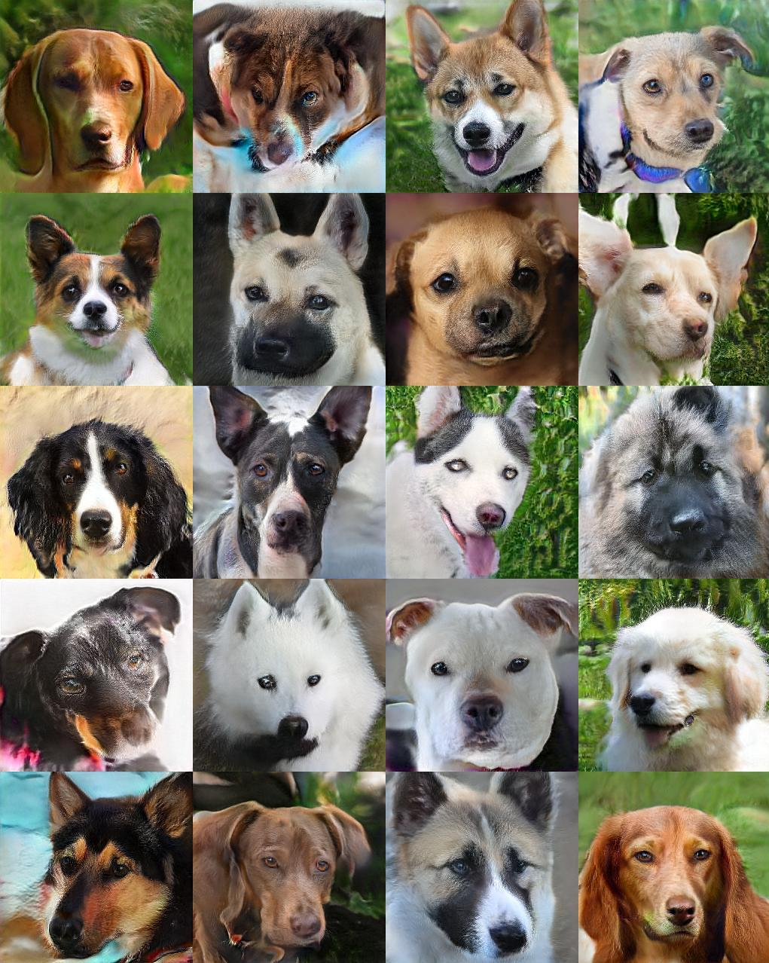
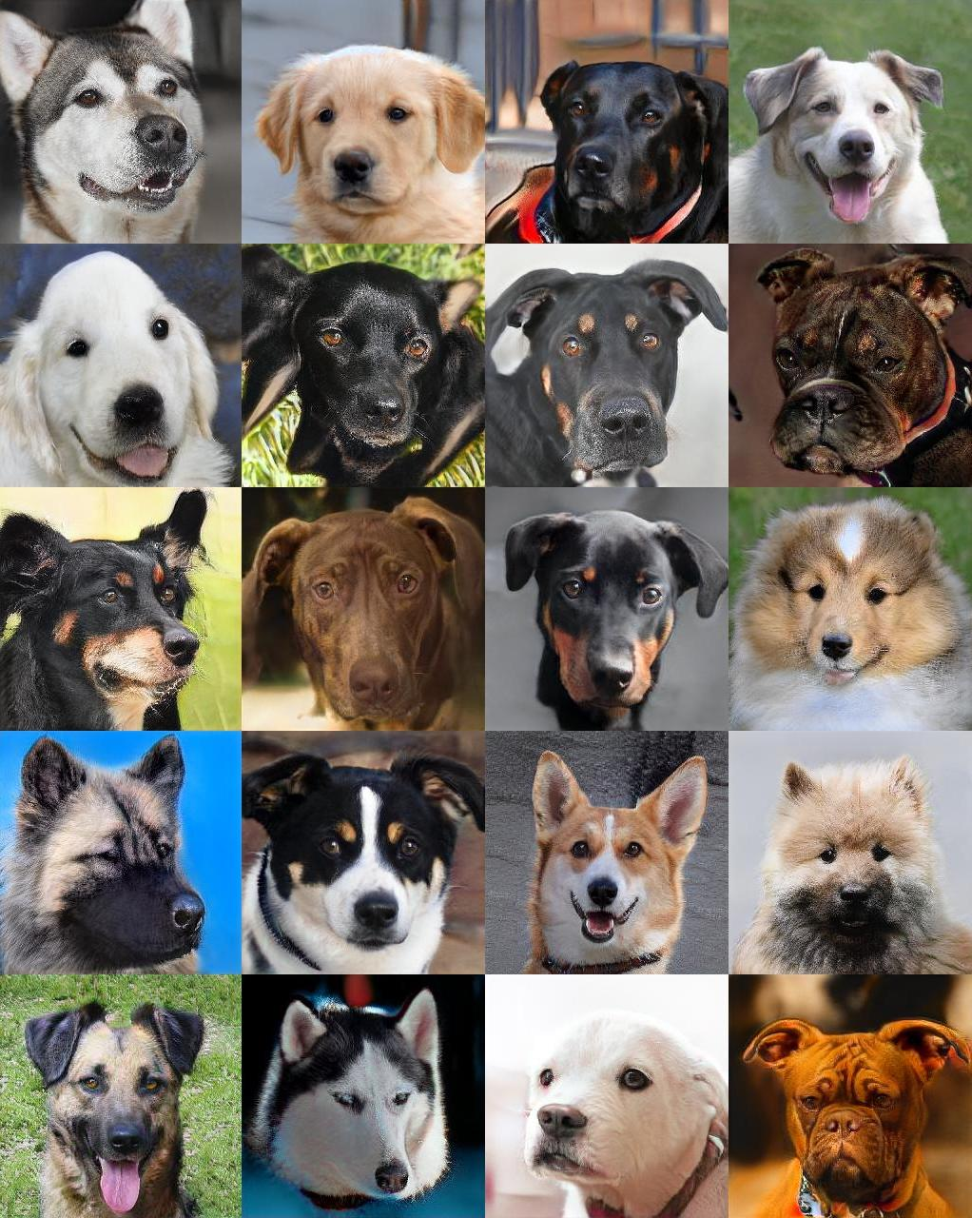
Cont. Result
Comparison with baseline StyleGAN2
Original baseline StyleGAN2
StyleGAN2-ADA
Figure 2. FID score as a function of wallclock time. Each curve corresponds to training the dataset from scratch with two NVIDIA Tesla V100 GPUs.
Figure 3. Uncurated 256×256 results generated for AFHQ-DOG (4739 images) with and without ADA. Both generators were trained from scratch for ~3 days.

Slide 12
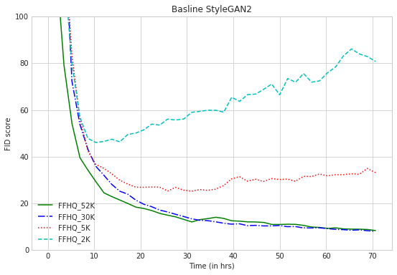
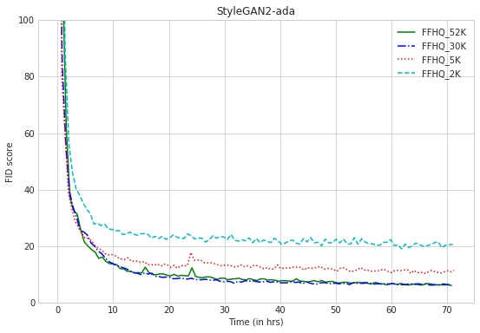
Cont. Results
Model performance with limited data
Figure 4. FID score as a function of wallclock time. Each curve corresponds to training the dataset from scratch with two NVIDIA Tesla V100 GPUs. Different lines color/shape correspond to different subsets of FFHQ.

Slide 13
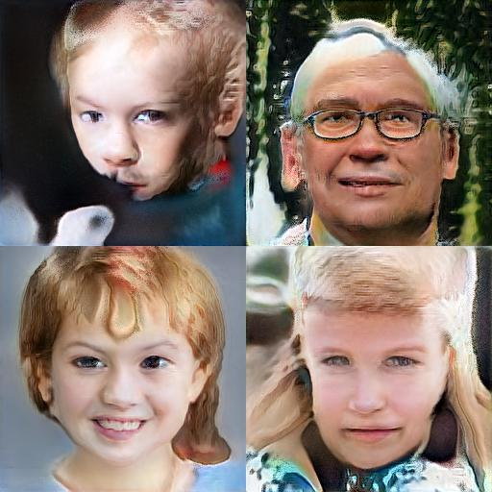
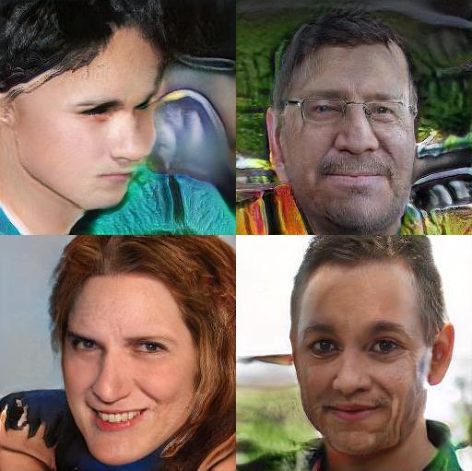
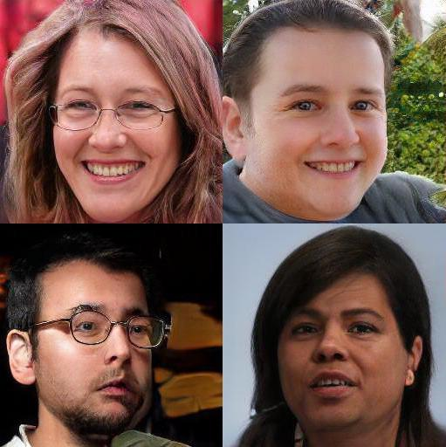
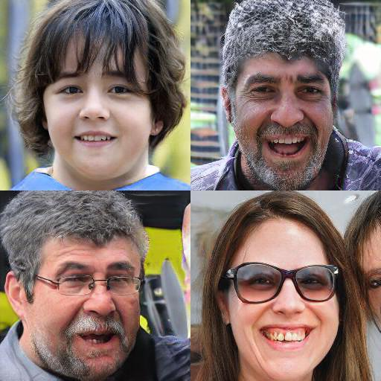
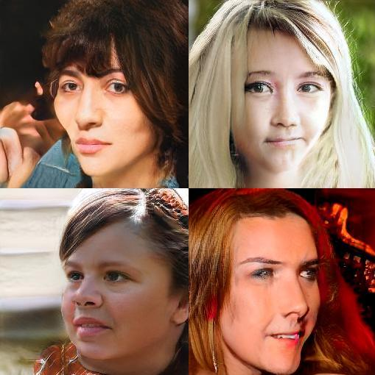
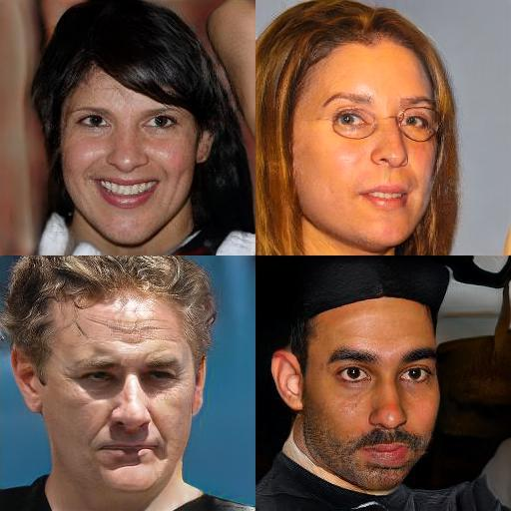
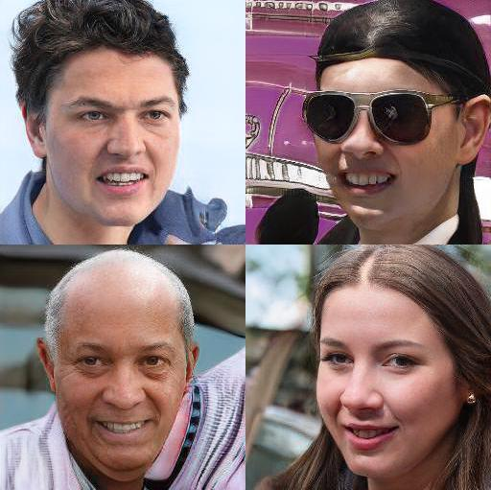
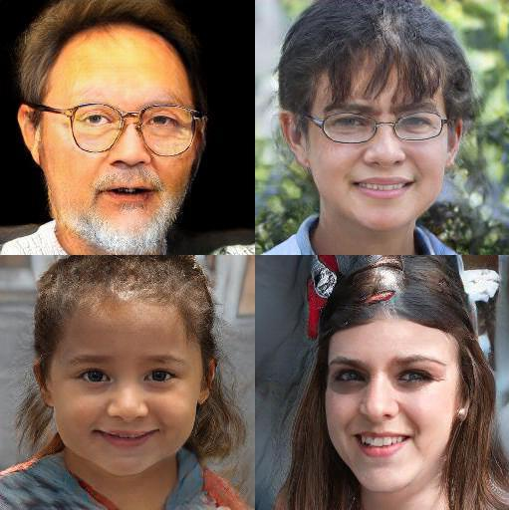
Cont. Results
2K training set
5K training set
30K training set
52K training set
Baseline StylegAN2
FID 46.09
FID 25.23
FID 8.06
FID 8.39
StyleGAN2-ada
FID 19.11
FID 10.39
FID 6.28
FID 6.16
Figure 5. Images generated for different subsets of FFHQ at 256×256 resolution. We show the best snapshot of the best training run for each case, selected according to FID.

Slide 14
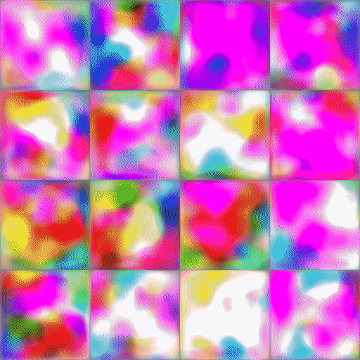
Discussion
StyleGAN2-ada performs a lot better than baseline StyleGAN2, especially when the quantity of the data is limited.
Models that did not employ augmentation, degrade noticeably as the size of the training set decreases, generally yielding poor image quality and diversity with fewer than 30k training images.
With ADA, the degradation is much more graceful, and the results remain reasonable even with a 5k training set.
*Animated image generated with the snapshots of the StyleGAN2-ada model trained from scratch on FFHQ.

Slide 15
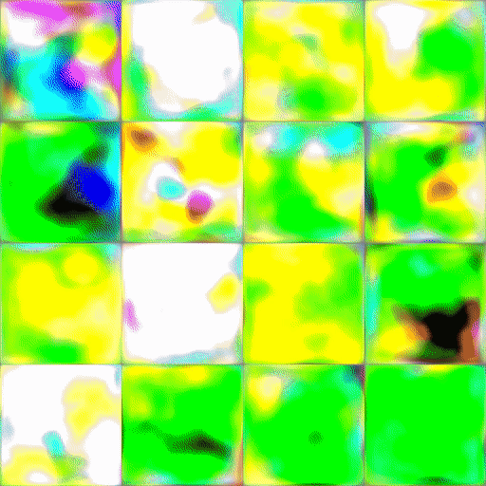
Conclusion
The ADA mechanism yields better results in a shorter time compared to baseline StyleGAN2.
The adaptive discriminator augmentation reliably stabilizes training.
Good results are possible using only a few thousand training images.
The experiments that we attempted to reproduce from the paper were reproducible.
Downsides: poor forward compatibility.
*Animated image generated with the snapshots of the StyleGAN2-ada model trained from scratch on AFHQ-WILD.

Slide 16

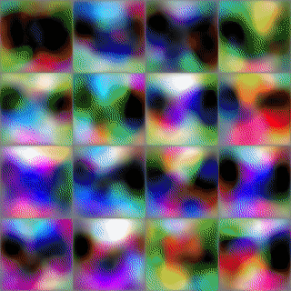
Thanks for Listening!
Any questions?
All source code to reproduce the reported results and figures are available on our GitHub repository and is ready for use with minimal to no adjustments.
https://github.com/Deep-FAMS/StyleGAN2-ada-Reproducibility
*Animated image is generated with the snapshots of the StyleGAN2-ada model trained from scratch on AFHQ-DOG.

